Slide 1
Judicial Archives and Deliberative Secrecy
Practice and Policy at the Supreme Court of Canada
Presented to the Canadian Association of Law Libraries
Rosalie Fox
Director, Library and Information Management
May 9, 2017

Slide 2
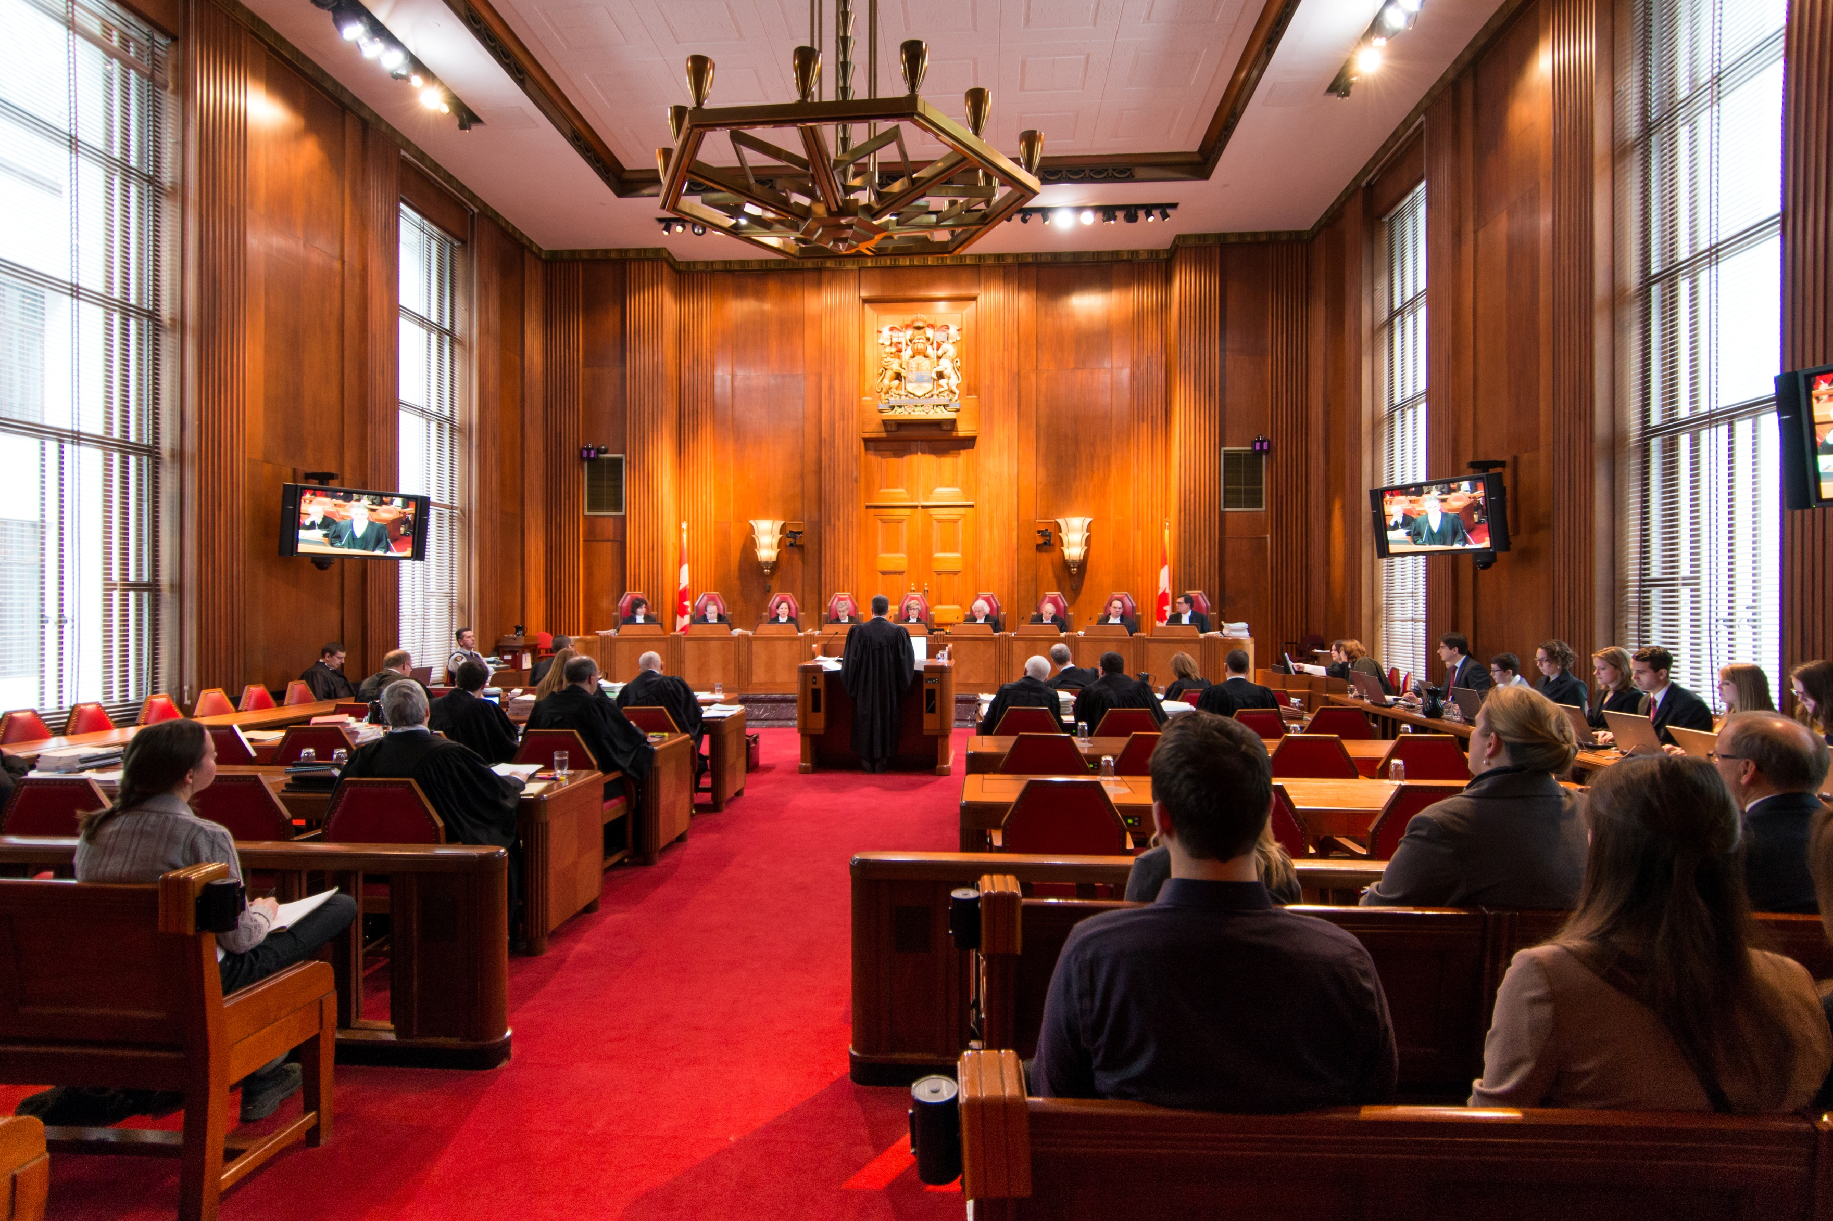
Supreme Court / Cour suprême

Slide 3
Organizational Chart / Organigram
Chief Justice of Canada
Juge en chef du Canada
Deputy Registrar
Registraire adjoint
Registrar
Registraire
Executive Legal Officer
Adjoint exécutif juridique
Communications Services
Service des communications
Judicial Support and Protocol Services Sector
Secteur du soutien aux juges et des services protocolaires
Court Operations Sector
Secteur des opérations de la Cour
Library/IM
Registry
Law Branch
Reports
Corporate Services Sector
Secteur des services intégrés

Slide 4
Libraries / Archives Differences and similarities
Published versus unpublished
Terminology
Policy framework
Policy on Access to Supreme Court Records
Treasury Board Policy on Information Management
Recordkeeping Directive, but not:
Library and Archives Act
Access to Information and Privacy Acts
Access conditions – Library use policy versus case sensitivity and legislative constraints
Preservation

Slide 5
Categories of Judicial Information
Supreme Court Case Files and Docket information
Judicial information
Collegial files (relates to Court case)
Chambers’ files (relates to Court case)
Judicial administrative files
Judges’ personal files (unrelated to Court cases)
Registry of the Supreme Court
Administrative / internal services records
Operational management of court cases

Slide 6
Case File
“Access” means the ability to request, view or obtain a copy of a Court Record;
“Case File” means the file maintained by the Records Centre of the SCC for a judicial proceeding that contains court records filed by litigants or produced by the Court. Court records contained in a case file may be in paper, microfilm or digital format;
“Court Record” means any document, correspondence, electronic communication, memorandum or note created or received by the SCC for the purpose of the processing of a judicial proceeding before the Court, with the exception of those documents, correspondence, electronic communications, memorandums or notes that fall under the definition of “Judicial Information”;
“Docket” means the register maintained by the SCC that lists and records all activities in a judicial proceeding;
“Judicial Information” means correspondence, electronic communications, memorandums and notes which are created by a Judge of the SCC, his or her law clerks or SCC court staff, in relation to judicial proceedings before the Court;

Slide 7
Typical Case File
Forms, notices and correspondence from parties related to Applications for Leave and Appeals
Application Record, Appeal Record
Factums, Memorandum of Argument
Books of Authorities
Responses
Replies
Affidavits
Orders, motions and judgments on applications for leave, appeals and taxations for costs
Exhibits and lower court record, lower court judgments
Register or Docket information contained in the Proceedings Management System
Minutes, hearing transcripts, webcasts and audio files of hearings
Reasons for judgment

Slide 8
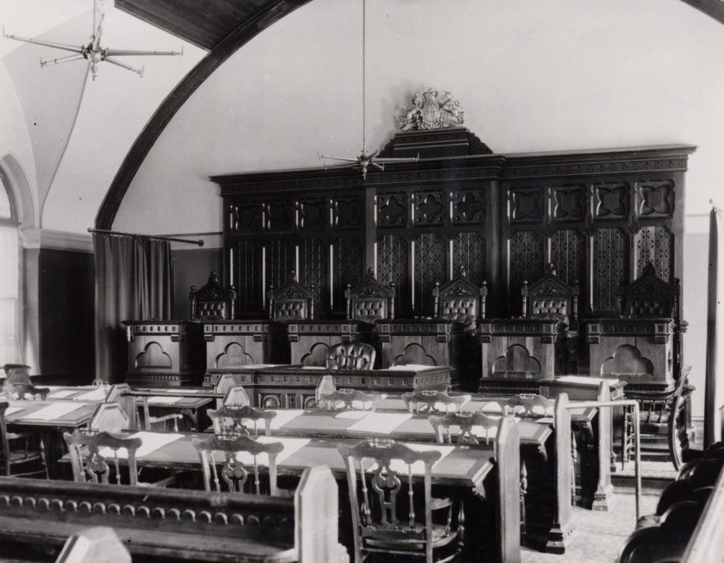
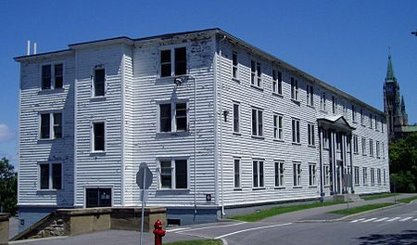
Preservation of case files at the Court
Storage limitations
Lack of knowledge on preservation technologies
MOU with National Archives
Custody not control
Only covered case files
Archival assessment
New terms and conditions
Donation of historical case files
Add judges’ collegial files

Slide 9
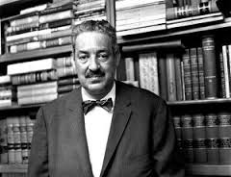
Ownership of deliberative materials
Triggered a review of how judicial information was managed
Creation of the concept of the Collegial file

Slide 10
Definitions
Judicial information refers to correspondence, electronic communications, memorandums and research notes which are created by a Judge of the Supreme Court of Canada (SCC), his or her law clerks or SCC court staff, in relation to judicial proceedings before the Court.
Chambers Documents refers to information resources such as correspondence, memorandums and notes created by a Justice, his or her Chambers’ personnel or law clerks, in relation to judicial proceedings before the Court that are not shared with other Justices or their Chambers’ personnel. These are judicial deliberative materials that are the property of the Justice.
Collegial Documents refers to IR’s such as correspondence, memorandums and notes created by a Justice, his or her Chambers’ personnel or law clerks, or legal counsel employed by the SCC, in relation to judicial proceedings before the Court that are shared with other Justices or their Chambers’ personnel or reflect the view of more than one justice. These are collegial judicial deliberative materials that are the property of and controlled by the Court.

Slide 11
Challenges
Making the case for preservation
No precedent for opening records of deliberations prior to judgement due to principle of deliberative secrecy
Determining limits of deliberative secrecy, impact of copyright law and how to manage solicitor-client privilege with respect to opinions prepared by staff lawyers
Clarifying definitions
Staying the course

Slide 12
Deliberative Secrecy
While we expect openness of deliberations in our legislative and administrative bodies, adjudicative processes have traditionally been secret. Not just in the Supreme Court, but in every other court in the country. Not just today, but dating back to the earliest days of the Republic and before. Not merely in this country or in the other common law jurisdictions, but almost without exception in the civilized world. This tradition of deliberative secrecy – which applies both to judges and lay factfinders – leads to an openness of discussion that enhances deliberations.
Kozinski, Alex (Judge of the United States Court of Appeals for the Ninth Circuit), “Book Review of Conduct Unbecoming, Closed Chambers: The First Eye Witness Account of the Epic Struggles Inside the Supreme Court, by Edward P. Lazarus” (New York: Times Books, 1998), Yale Law Journal, Vol. 108, Issue 4 (January 1999), pp. 836-878, at p. 874.

Slide 13
Other jurisdictions
.
Collegial files appear to be unique in the Canadian context
Other Canadian jurisdictions allow their judges to manage, control and dispose of their judicial information as personal papers
No distinction is drawn between deliberative materials (such as bench memos, draft judgments and notes on discussions between panel members on a court of appeal) generated through ‘collegial deliberation’ or collaboration, and other types of notes, bench memos and drafts not circulated or shared with colleagues on the bench.
US, UK and Australia encourage archiving of judicial information to their national archives – the judge decides
France, Italy, the Netherlands, Belgium and Austria, among others, do not allow dissents
EU Court of Justice – no dissenting opinions allowed

Slide 14
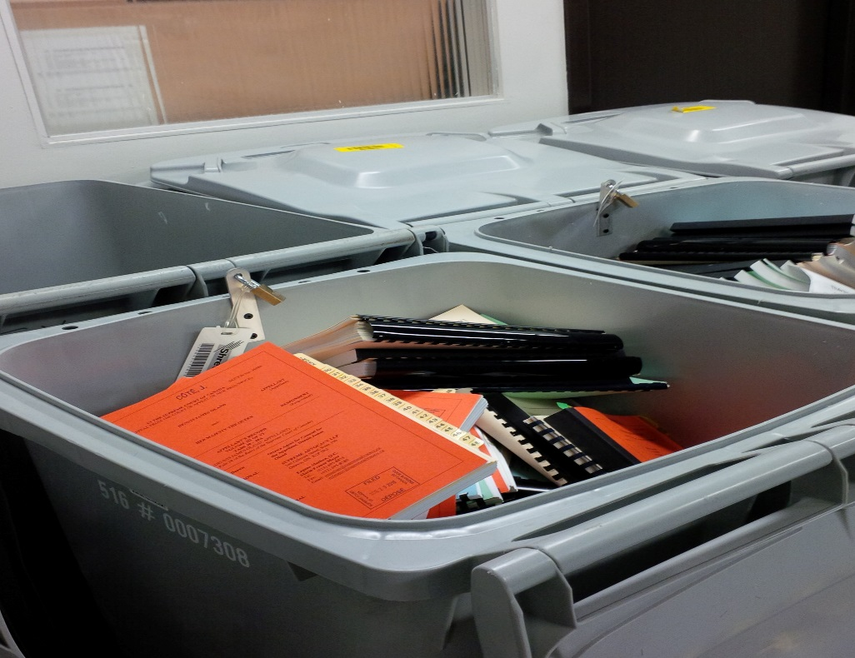
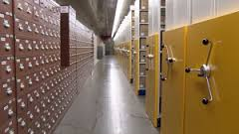
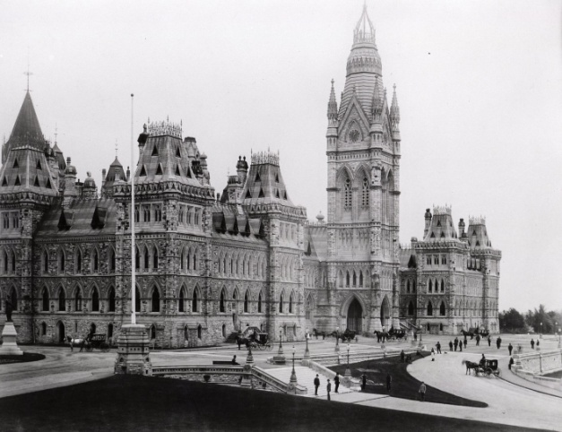
Successes and Next Steps
Successes
No destruction of Deliberative material. Public access in 50 years after judgment is rendered for deliberative material.
Judges retain control over Chambers and Personal papers.
Next steps
Transfer to Library and Archives.
Consultation of non-active case files will be at LAC for all cases prior to 1967.
Digitization?

Slide 15
Ongoing challenges
Backlogs
Electronic communications
Preserving the digital record, and
Making the case file official in e-format

